Slide 1
Synthesis of an RNA Transcript
The three stages of transcription
Initiation
Elongation
Termination

Slide 2
RNA Polymerase Binding and Initiation of Transcription
Promoters signal the transcriptional start point and usually extend several dozen nucleotide pairs upstream of the start point
Transcription factors mediate the binding of RNA polymerase and the initiation of transcription
The completed assembly of transcription factors and RNA polymerase II bound to a promoter is called a transcription initiation complex
A promoter called a TATA box is crucial in forming the initiation complex in eukaryotes

Slide 3
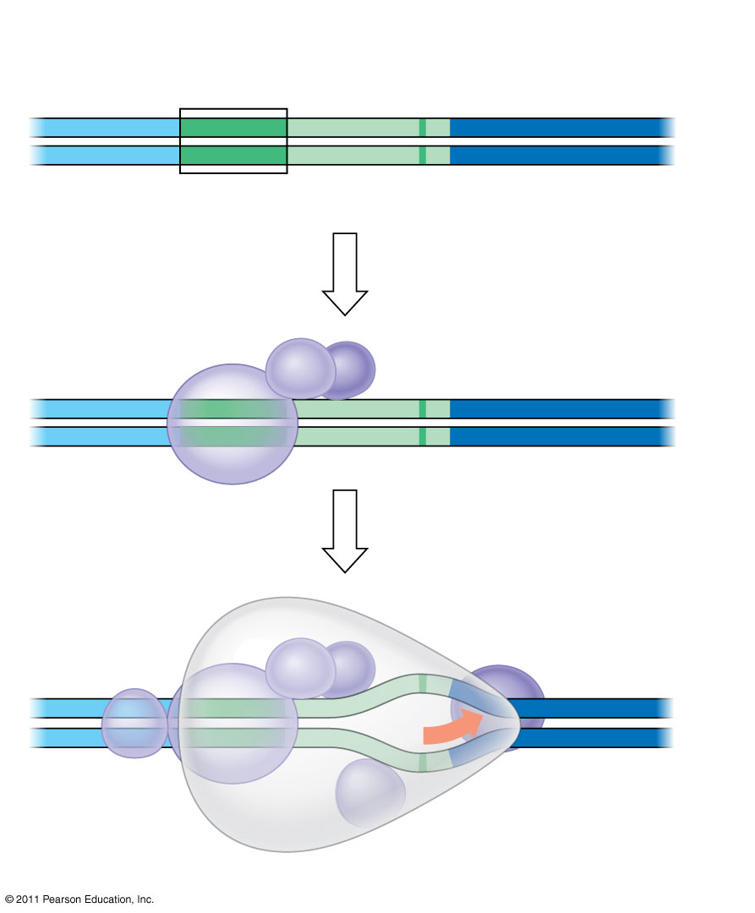
Figure 17.8
1
A eukaryotic promoter
Promoter
Nontemplate strand
DNA
5′
T
A
T
A
A
A
A
3′
3′
A
T
A
T
T
T
T
5′
TATA box
Start point
Template strand
2
Several transcription factors bind to DNA
Transcription factors
5′
3′
3′
5′
3
Transcription initiation complex forms
RNA polymerase II
Transcription factors
5′
3′
3′
3′
5′
5′
RNA transcript
Transcription initiation complex
Notes:
Figure 17.8 The initiation of transcription at a eukaryotic promoter.

Slide 4
Elongation of the RNA Strand
As RNA polymerase moves along the DNA, it untwists the double helix, 10 to 20 bases at a time
Transcription progresses at a rate of 40 nucleotides per second in eukaryotes
A gene can be transcribed simultaneously by several RNA polymerases
Nucleotides are added to the 3′ end of the growing RNA molecule

Slide 5
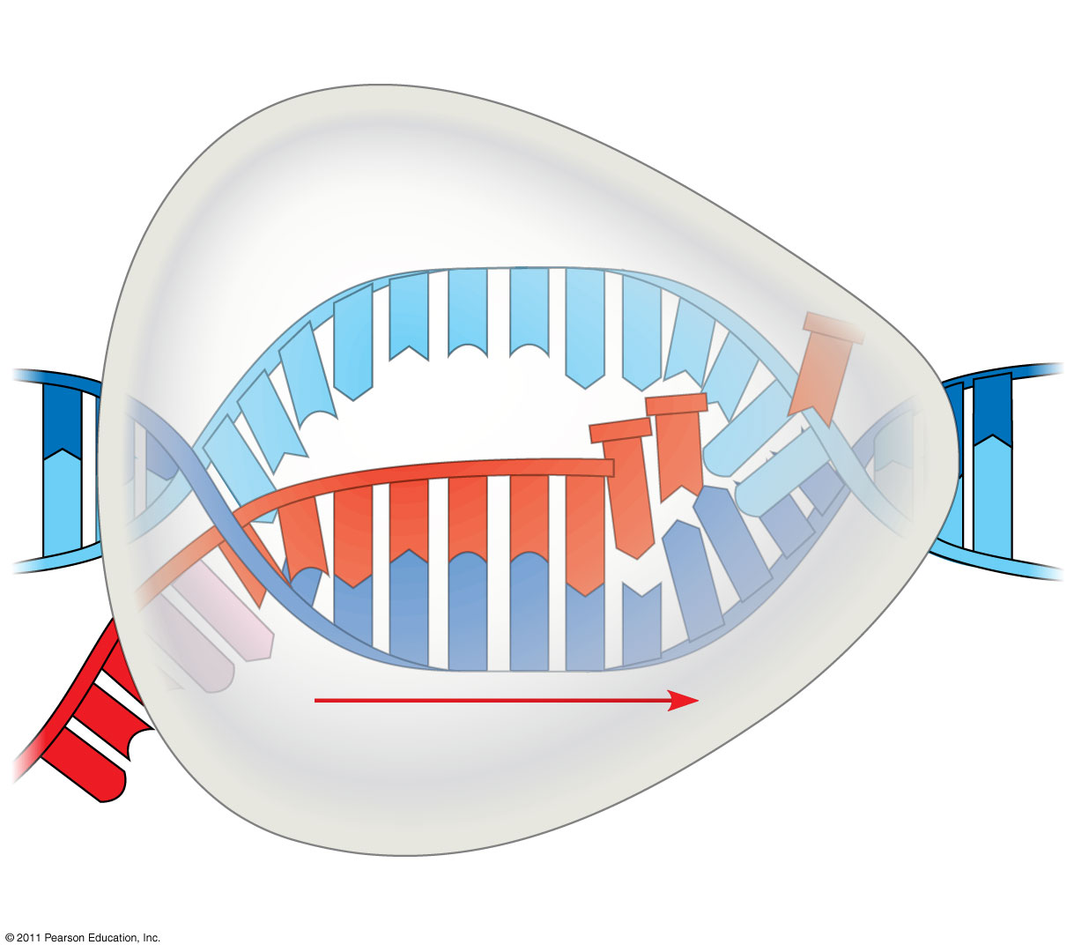
Figure 17.9
Nontemplate strand of DNA
RNA nucleotides
RNA polymerase
A
T
C
C
A
A
3′
T
5′
C
T
U
3′
end
G
T
A
U
G
A
C
C
A
U
C
C
A
C
A
5′
A
3′
T
A
G
G
T
T
5′
Direction of transcription
Template strand of DNA
Newly made RNA
Notes:
Figure 17.9 Transcription elongation.

Slide 6
Termination of Transcription
The mechanisms of termination are different in bacteria and eukaryotes
In bacteria, the polymerase stops transcription at the end of the terminator and the mRNA can be translated without further modification
In eukaryotes, RNA polymerase II transcribes the polyadenylation signal sequence; the RNA transcript is released 10–35 nucleotides past this polyadenylation sequence

Slide 7
Eukaryotic cells modify RNA after transcription
Enzymes in the eukaryotic nucleus modify pre-mRNA (RNA processing) before the genetic messages are dispatched to the cytoplasm
During RNA processing, both ends of the primary transcript are usually altered
Also, usually some interior parts of the molecule are cut out, and the other parts spliced together

Slide 8
Alteration of mRNA Ends
Each end of a pre-mRNA molecule is modified in a particular way
The 5′ end receives a modified nucleotide 5′ cap
The 3′ end gets a poly-A tail
These modifications share several functions
They seem to facilitate the export of mRNA to the cytoplasm
They protect mRNA from hydrolytic enzymes
They help ribosomes attach to the 5′ end

Slide 9
Figure 17.10
Protein-coding segment
Polyadenylation signal
5′
3′
G
P
P
P
AAUAAA
AAA
…
AAA
Cap
5′
Start codon
Stop codon
5′
UTR
3′
UTR
Poly-A tail
Notes:
Figure 17.10 RNA processing: Addition of the 5′ cap and poly-A tail.

Slide 10
Split Genes and RNA Splicing
Most eukaryotic genes and their RNA transcripts have long noncoding stretches of nucleotides that lie between coding regions
These noncoding regions are called intervening sequences, or introns
The other regions are called exons because they are eventually expressed, usually translated into amino acid sequences
RNA splicing removes introns and joins exons, creating an mRNA molecule with a continuous coding sequence

Slide 11
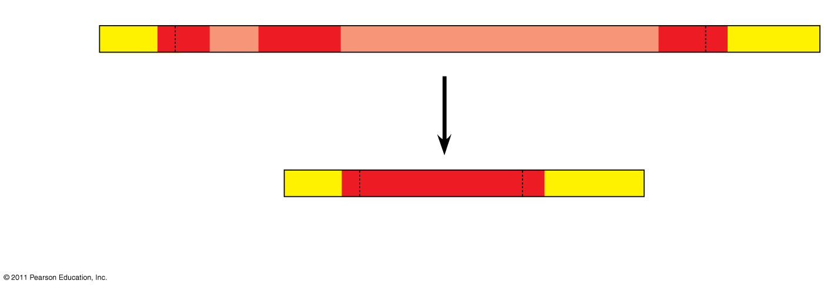
Figure 17.11
5′
Exon Intron
Exon
Intron
Exon
3′
Pre-mRNA Codon numbers
5′
Cap
Poly-A tail
1−30
31−104
105− 146
Introns cut out and exons spliced together
mRNA
5′
Cap
Poly-A tail
1−146
5′
UTR
3′
UTR
Coding segment
Notes:
Figure 17.11 RNA processing: RNA splicing.

Slide 12
In some cases, RNA splicing is carried out by spliceosomes
Spliceosomes consist of a variety of proteins and several small nuclear ribonucleoproteins (snRNPs) that recognize the splice sites

Slide 13
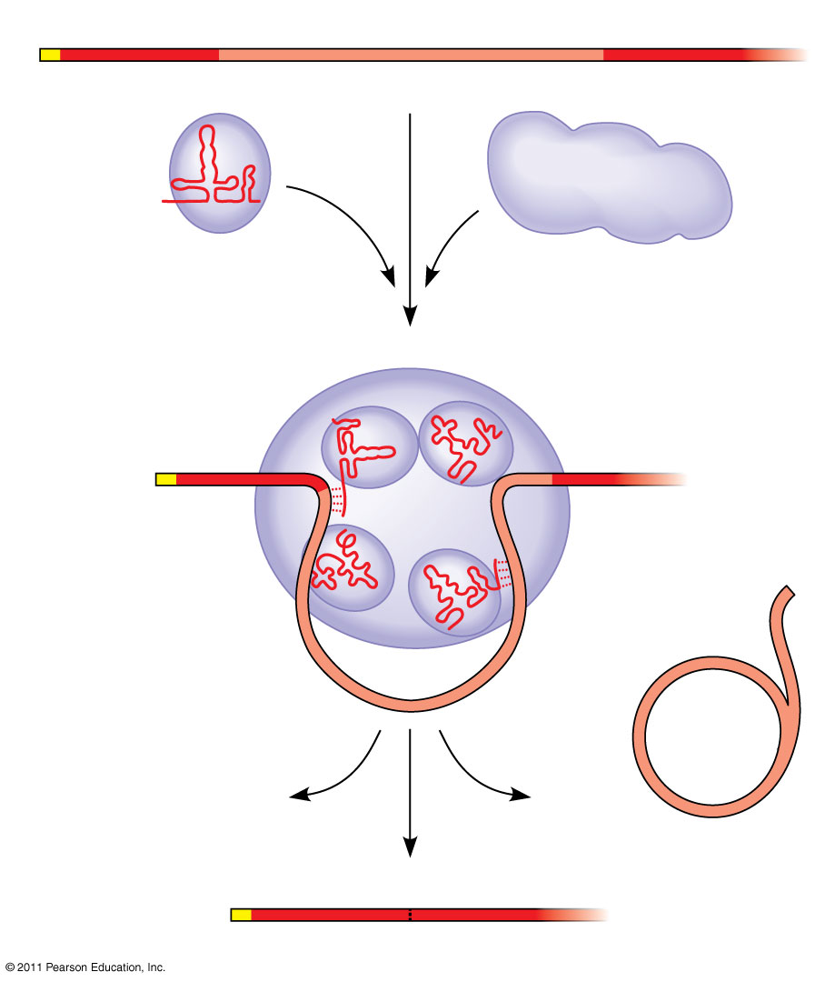
Figure 17.12-3
RNA transcript (pre-mRNA)
5′
Exon 1
Intron
Exon 2
Protein
Other proteins
snRNA
snRNPs
Spliceosome
5′
Spliceosome components
Cut-out intron
mRNA
5′
Exon 1
Exon 2
Notes:
Figure 17.12 The roles of snRNPs and spliceosomes in pre-mRNA splicing.

Slide 14
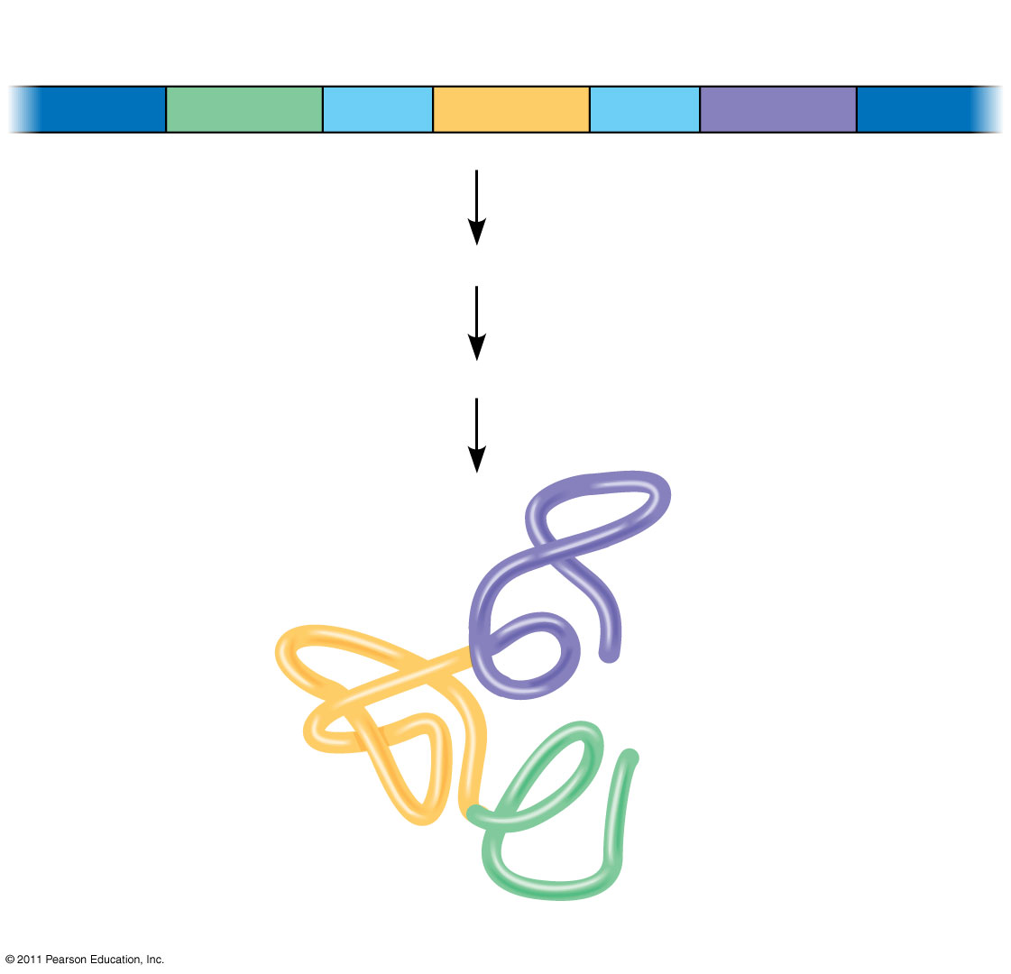
Figure 17.13
Gene
DNA
Exon 1
Intron
Exon 2
Intron
Exon 3
Transcription
RNA processing
Translation
Domain 3
Domain 2
Domain 1
Polypeptide
Notes:
Figure 17.13 Correspondence between exons and protein domains.

Slide 15
Molecular Components of Translation
A cell translates an mRNA message into protein with the help of transfer RNA (tRNA)
tRNAs transfer amino acids to the growing polypeptide in a ribosome
Translation is a complex process in terms of its biochemistry and mechanics

Slide 16
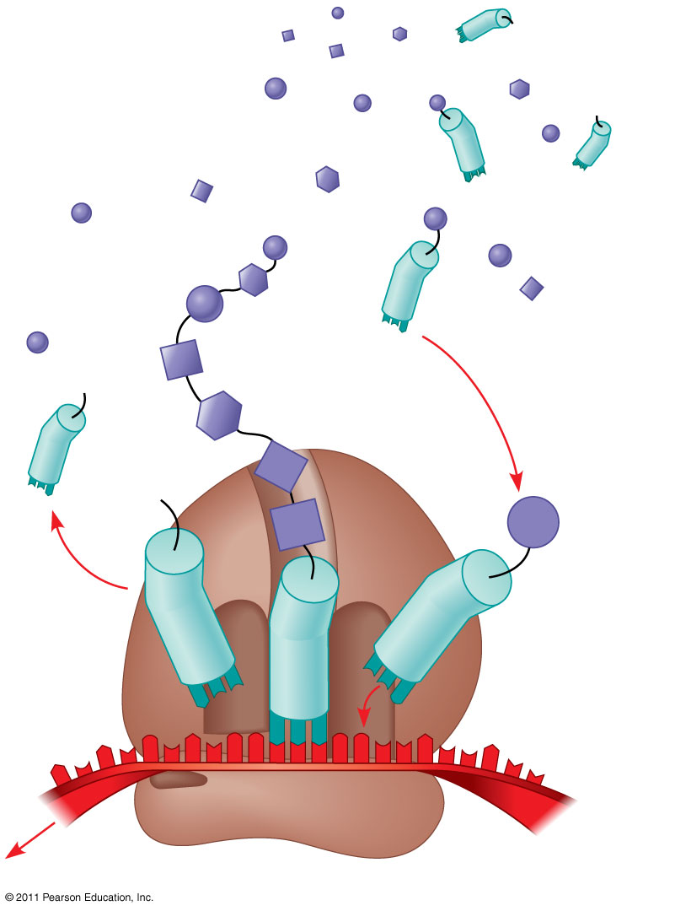
Figure 17.14
Amino acids
Polypeptide
tRNA with amino acid attached
Ribosome
Trp
Phe
Gly
tRNA
C
C
C
C
C
G
Anticodon
A
C
G
A
A
A
G
U
G
G
U
U
U
G
G
C
5′
Codons
3′
mRNA
Notes:
Figure 17.14 Translation: the basic concept.

Slide 17
The Structure and Function of Transfer RNA
Molecules of tRNA are not identical
Each carries a specific amino acid on one end
Each has an anticodon on the other end; the anticodon base-pairs with a complementary codon on mRNA

